Slide 1

HOUSING DATASET ANALYSIS
USING PYTHON
KIRAN M
DA&DS
2025 MAY BATCH

Slide 2
INTRODUCTION
Brief outline of the analysis process for a housing dataset.
Problem Statement: What factors most influence property prices?
Objective: Leverage data analytics to enhance housing market decisions.

Slide 3
DATA UNDERSTANDING
Source: Real estate listings data.
Rows: 4,600+
Columns: 21
Key Attributes:
Price, bedrooms, bathrooms, sqft_living, sqft_lot, city, year built, etc.
Sample Data Table:
Price | Bedrooms | Sqft Living | City | Year Built
313,000 | 3 | 1,340 | SHORELINE | 1955
461,000 | 5 | 3,650 | SEATTLE | 1921

Slide 4
Why? Ensures reliability and accuracy in analysis.
Key Steps:
Removed columns: date, street
Created new features: property_age, price_per_sqft
Corrected datatypes for numeric/categorical fields
Approach: Systematic transformation for consistency.
DATA CLEANING

Slide 5
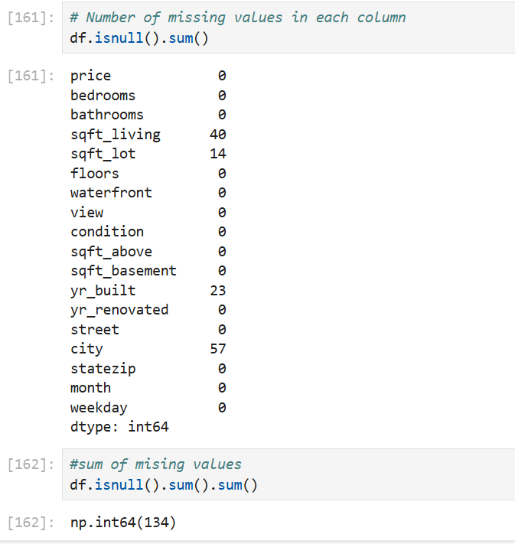
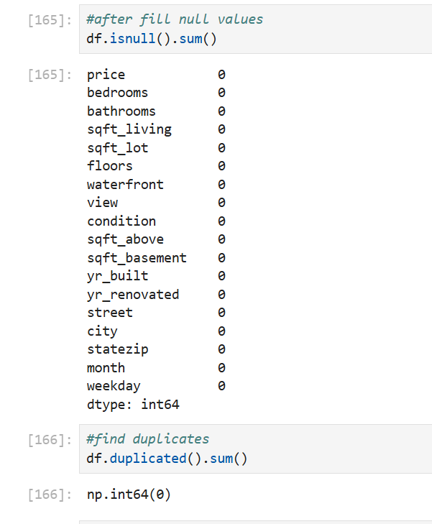
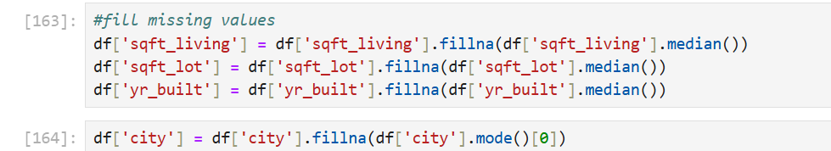
HANDLING MISSING VALUES
Method: Eliminated rows with missing key data (sqft_living, city).
Proportion: Very few rows impacted.
Visuals: Bar chart of missing values by feature.

Slide 6
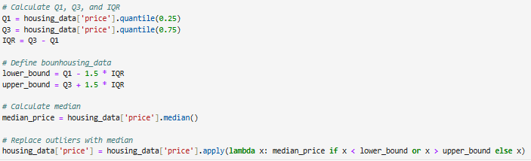
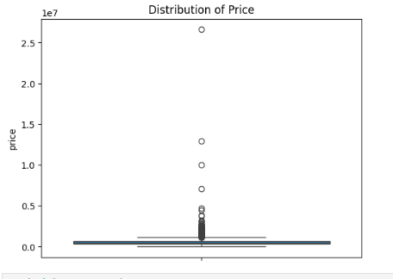
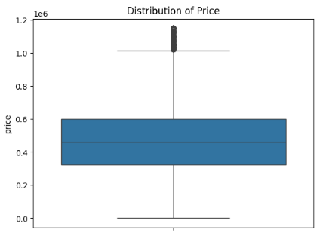
OUTLIER HANDLING
Identification: Used boxplots and statistical summaries.
Cleansing: Capped extreme values in price, area.
Result: More robust distributions for modeling.
`

Slide 7
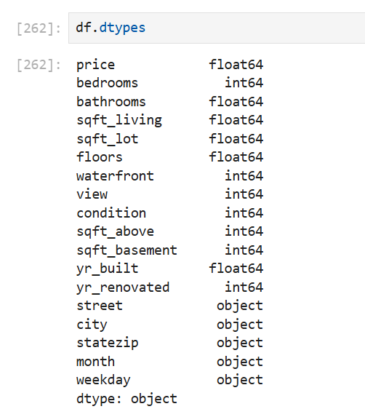
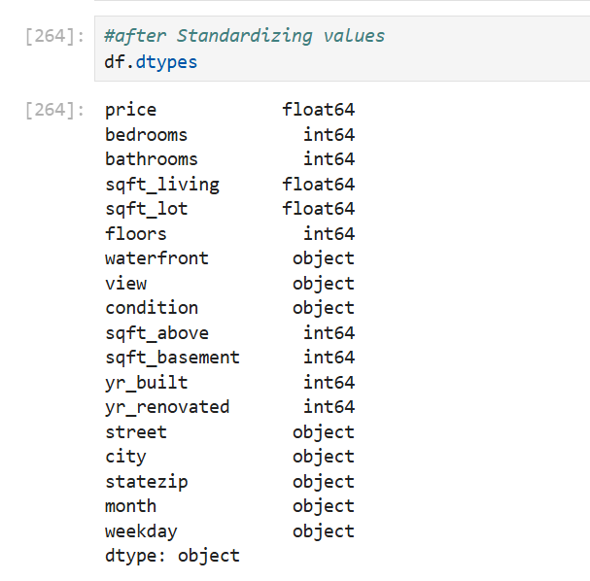
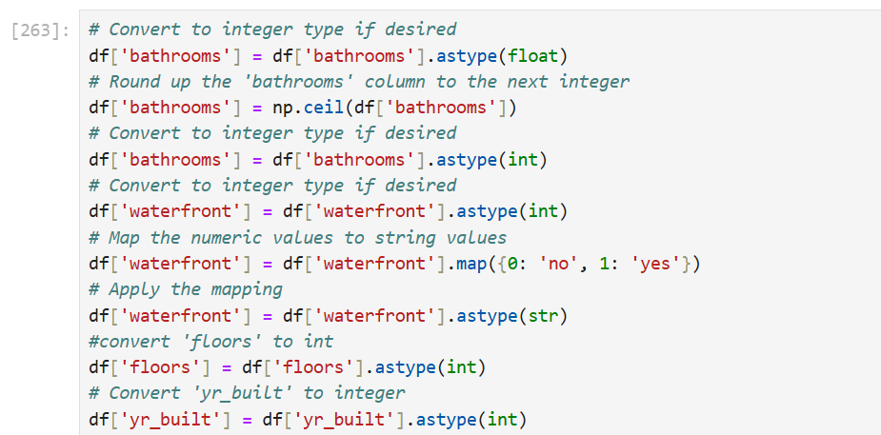
HANDLING INVALID VALUES
Examples: Properties with 0 bathrooms or negative/zero square footage.
Action: Removed or corrected these records.
Summary: Improved data validity for downstream steps.

Slide 8
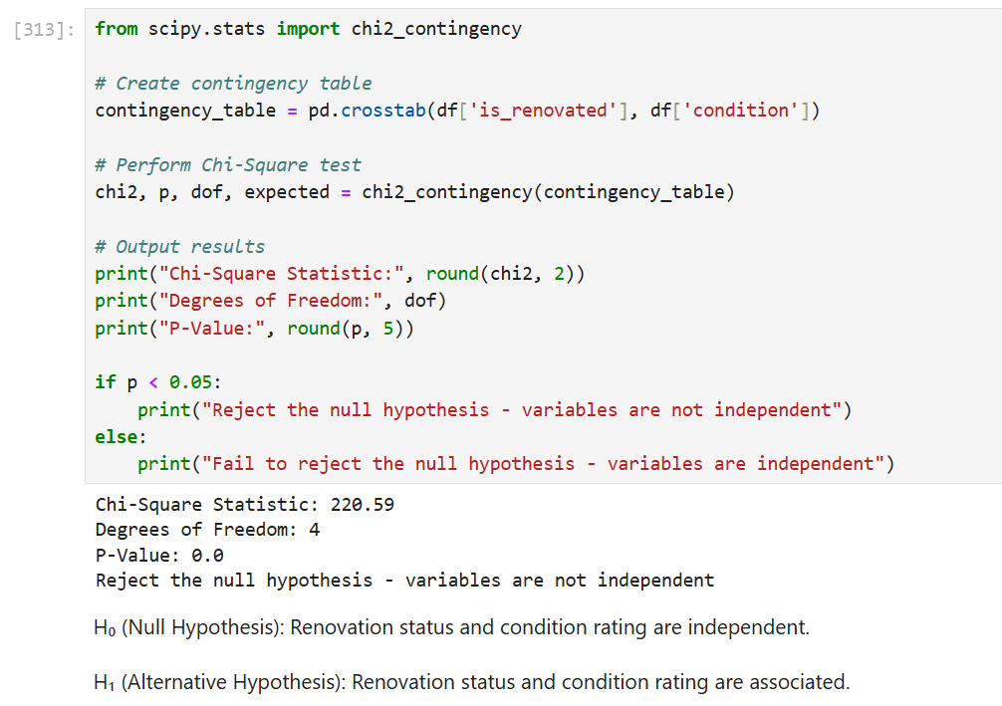
STATISTICAL ANALYSIS
Tests Performed:
T-tests for differences in price by renovation status.
ANOVA for condition vs. price.
Chi-square for categorical relationships.
Findings: Significant factors influencing price include renovation, condition, and property size.

Slide 9
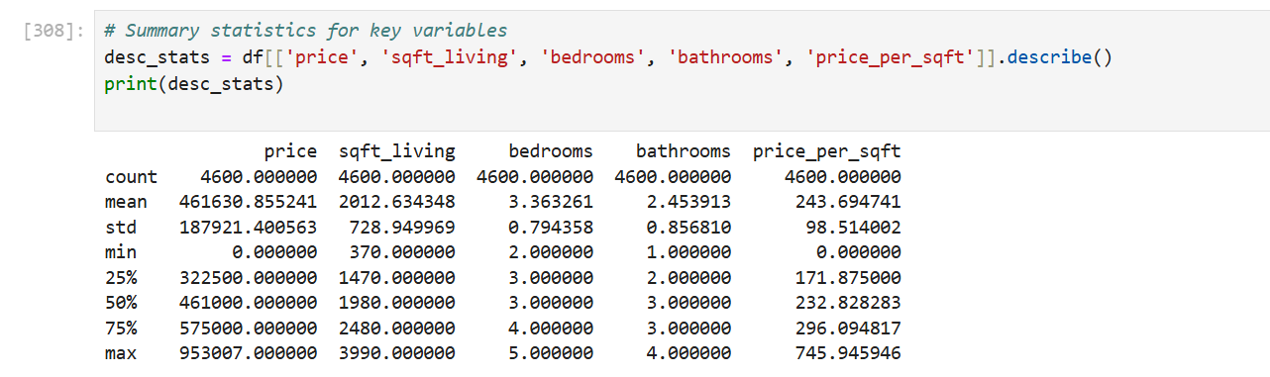
DESCRIPTIVE ANALYSIS
Tests Performed:
T-tests for differences in price by renovation status.
ANOVA for condition vs. price.
Chi-square for categorical relationships.
Findings: Significant factors influencing price include renovation, condition, and property size.

Slide 10
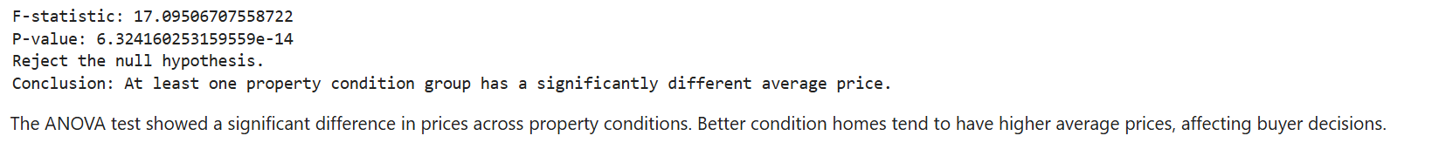
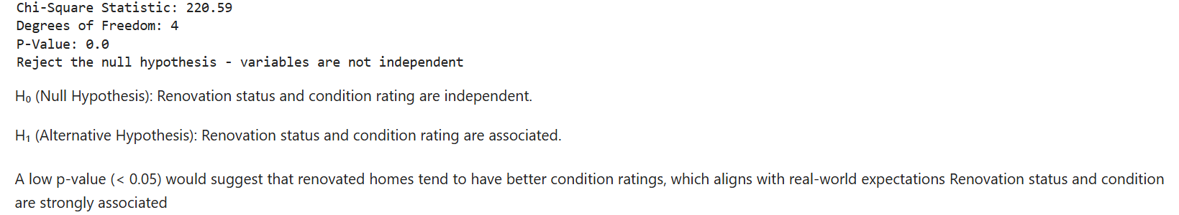
RELATIONSHIP BETWEEN VARIABLES
Variables: Price, sqft_living, bedrooms, renovations, city
Analysis: Correlation and group differences.
Result: Living area, renovation, and city location most strongly impact price.

Slide 11
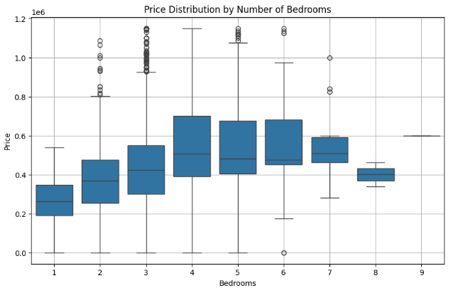
DATA VISUALIZATION
Purpose: Communicate trends and discoveries.
Types Used:
Histograms (price, area)
Scatter plots (sqft vs. price)
Boxplots (condition vs. price)
Heatmaps (feature correlations)

Slide 12
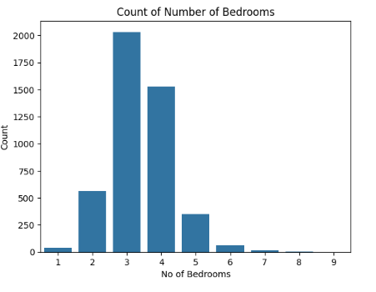
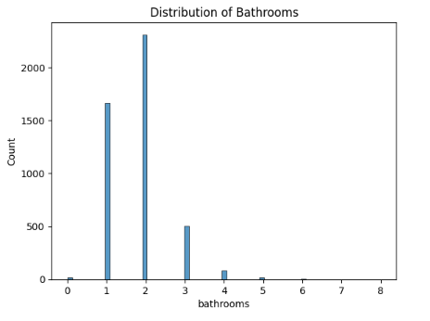
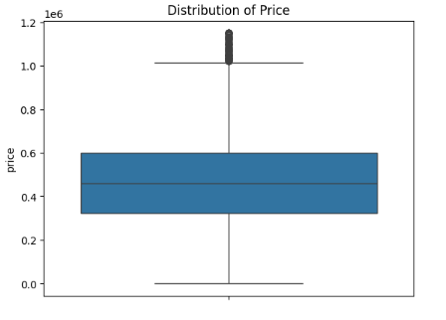
UNIVARIATE ANALYSIS
Focus: Distributions of individual features
Findings:
Bedrooms and bathrooms cluster at lower values
Most homes: 3-4 bedrooms, 2-3 bathrooms
Suggestion: Histogram of price; barplot of bedroom counts

Slide 13
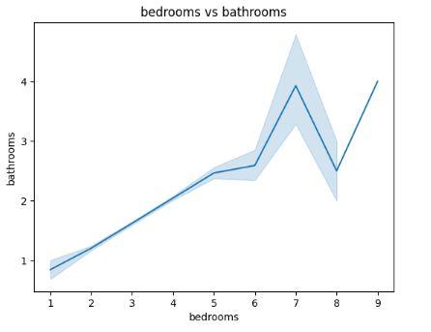
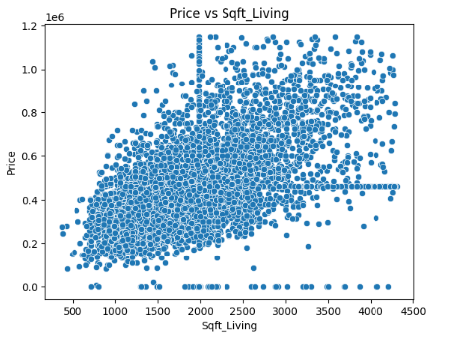
BIVARIATE ANALYSIS
Comparisons: Price vs. sqft_living, condition, year_built
Findings: Larger homes → higher prices; newer and better-conditioned properties cost more
Suggestion: Scatter and box plots

Slide 14
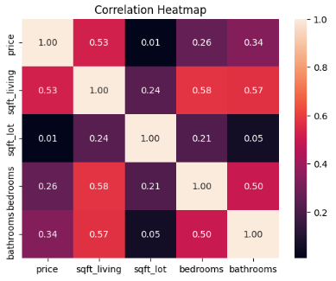
MULTIVARIATE ANALYSIS
PaiTechnique: Pairplots and grouped bar charts
Trends: Price varies by city and house size; top cities and premium home sizes command highest values

Slide 15
CONCLUTION ANDRECOMENTATION
Key Insights:
Size, location, and renovation are primary drivers of housing value.
Data-driven pricing strategies recommended for investment success.
Action Items:
Renovate and upgrade for increased value.
Prioritize properties in prime locations.
Future Work: Further modeling and time-trend analysis.

Slide 16
Thank You

